Slide 1

WEST GODAVARI INSTITUTE OF SCIENCE AND
ENGINEERING (AUTONOMOUS)
Department of Electronics and Communication Engineering
Design and Implementation of a Raspberry Pi Controlled Drone
for Women's Safety and Intervention
Under the esteemed Guidance of Mr. K. VEERANNA BABU, MTech
Presented by
1. A. BALA DAYAKAR (22PD5A0403)
2. B. SIVA SAI KUMAR (21PD1A0402)
3. D. JHANAVI (21PD1A0404)
4. B. MOHANA SURYANARAYANA (22PD5A0405)
5. Y. SAI RAMA PRATYUSHA (22PD5A0434)

Slide 2
CONTENT
Department of ECE
Introduction
History
Types of Drones
Women Protection Drone
Technical aspects
Experimental Result
Application of drone
Advantages
Conclusion

Slide 3
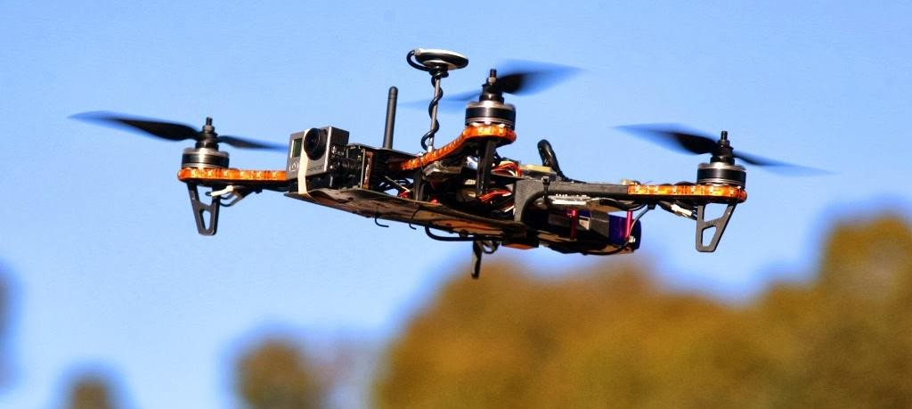
INTRODUCTION
Department of ECE
An UAV commonly known as a drone and referred to as a Remotely Piloted Aircraft .
Drones are used in military, agriculture, environmental monitoring, and delivery services.
They help in surveillance, mapping, and rescue missions.
There are 3- flight zones
Green (60-120meters)
Yellow (60-120meters)
Red (no fly zone )
Fig-1drone

Slide 4
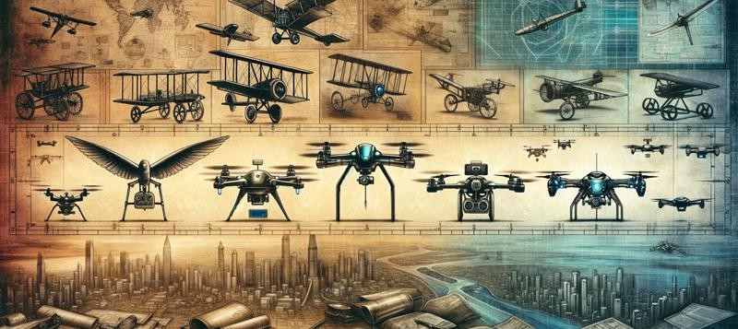
HISTORY
Department of ECE
The first attempts drone creation took place During the First World War with by the Archibald Low in Great Britain.
But it was in 1917 than in France, max Boucher really sets the date drone invention on July 2,1917 to be exact
Fig -1 History of Drones

Slide 5
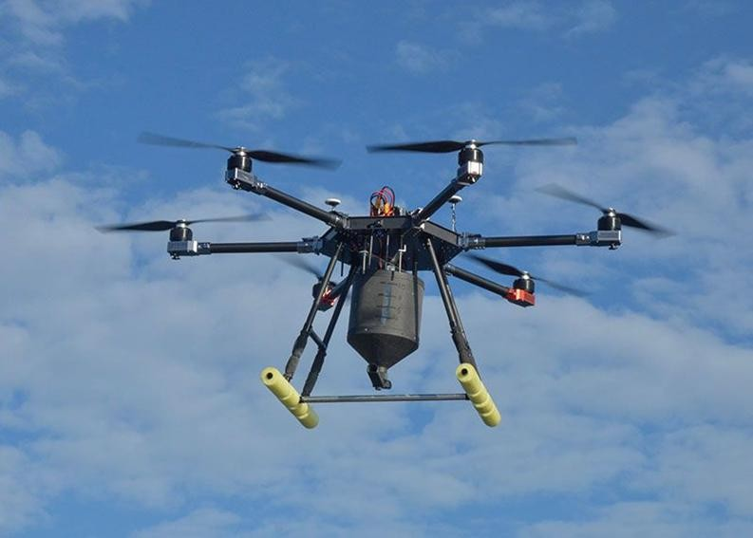
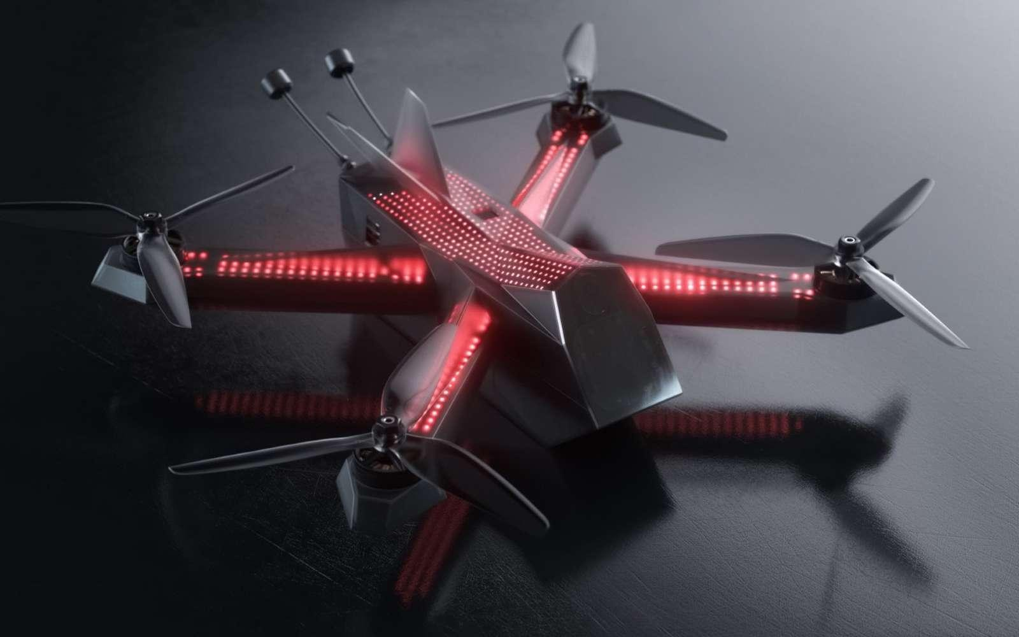
TYPES OF DRONES
Application Drones
Application drones are used for spraying fertilizers, pesticides, and nutrients efficiently in agriculture the figure-1.1 shown in below
Racing Drones
Racing drones are high-speed, agile UAVs designed for competitive flying through obstacle courses the figure-1.2 shown in below
Fig-1.1 Application Drone
Fig-1.2 Racing Drone

Slide 6
WOMEN PROTECTION DRONE
Department of ECE
Women’s safety drones use GPS, cameras, and sensors for tracking, monitoring, alerting, and deterrence.
Activation: A distress signal activates the drone via a mobile app or panic button.
Tracking: The drone uses GPS to locate the individual and navigate to her location. Monitoring: The drone records real-time footage and sends it to law enforcement. Alert System: The drone alerts police with the victim's location and situation details.
Deterrence: Some drones are equipped with loudspeakers or flashing lights to deter potential threats.

Slide 7
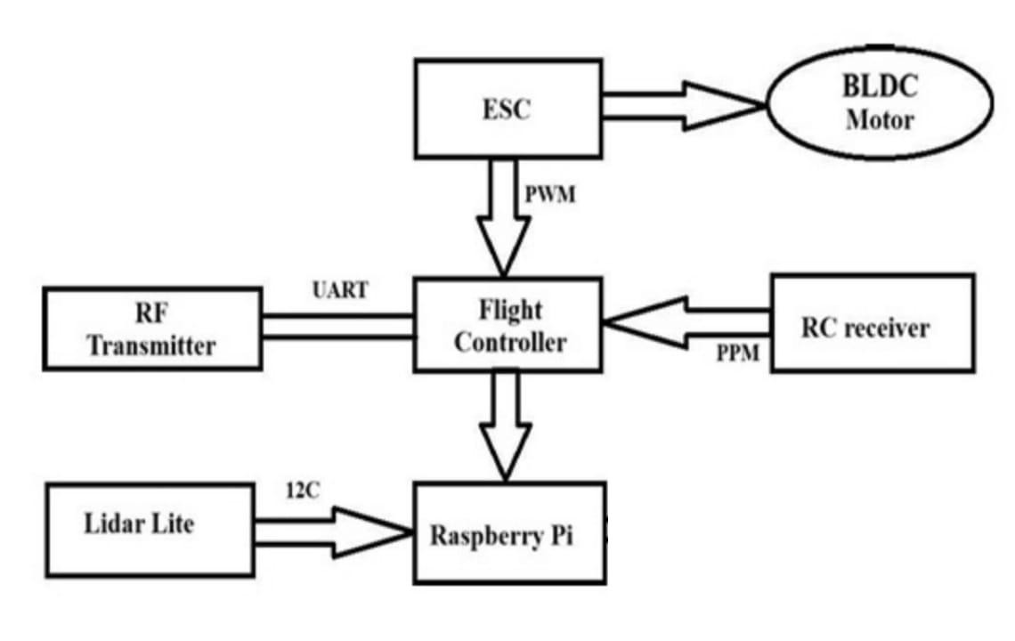
BLOCK DIAGRAM
Department of ECE
Fig-1.1 Block Diagram of Women Protection Drone

Slide 8
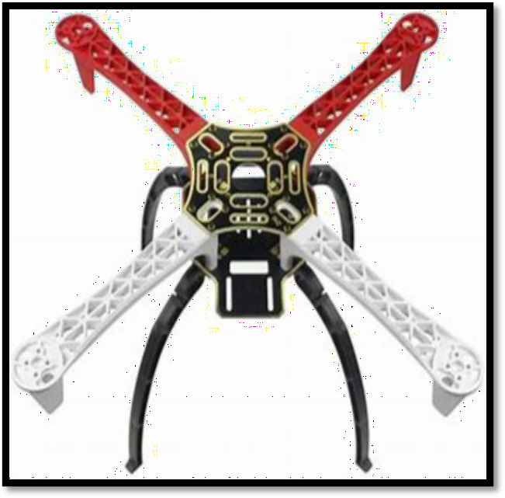
HARDWARE COMPONENTS
Department of ECE
FRAME
A drone frame is the main structural component that holds all other parts together.
It determine the drone’s size shape , and strength. F450 / Q450 Quadcopter Frame. As shown in below figure -1.1 Quadcopter Frame
Fig -1.1 Frame

Slide 9
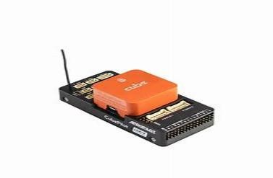
Department of ECE
FLIGHT CONTROLLER ( FC)
Cube Orange runs on open-source flight controller software it providing users with a rich ecosystem of features, customization options, And community support .As shown in below figure-1.2
A flight controller is the "brain" of a drone, responsible for managing its flight operations. It interprets user inputs and sensor data to control the drone's motors, ensuring stability, altitude maintenance.
Fig-1.2 Flight controller (FC)

Slide 10
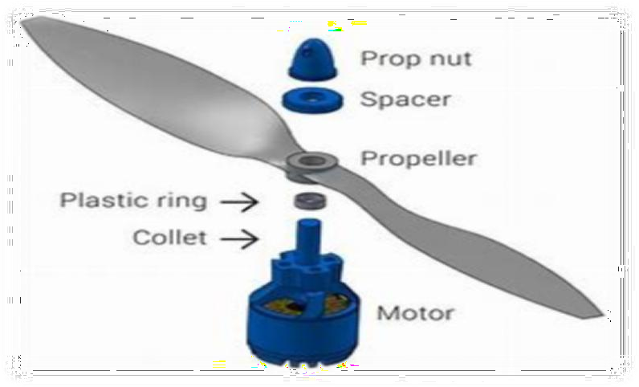
MOTORS AND PROPELLERS
Department of ECE
t
The drone has four or more motors, each connected to a propeller.
The motors spin the propellers at high speeds, generating lift to make the drone fly. As shown in below figure-1.3 motors and propellers
Fig -1.3 Motors and Propellers

Slide 11
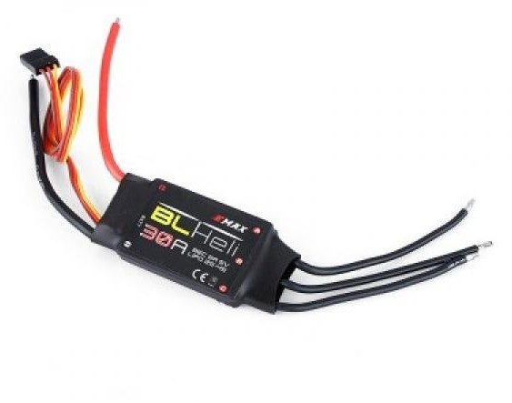
ESC’S
Department of ECE
The Electronic Speed Controller (ESC) is a crucial part of the drone’s flight system. It
controls the speed of the brushless DC motors, allowing the drone to fly smoothly and respond to commands. As shown in below figure -1.4 ECS’s
Fig -1.4 Electronics Speed Controller

Slide 12
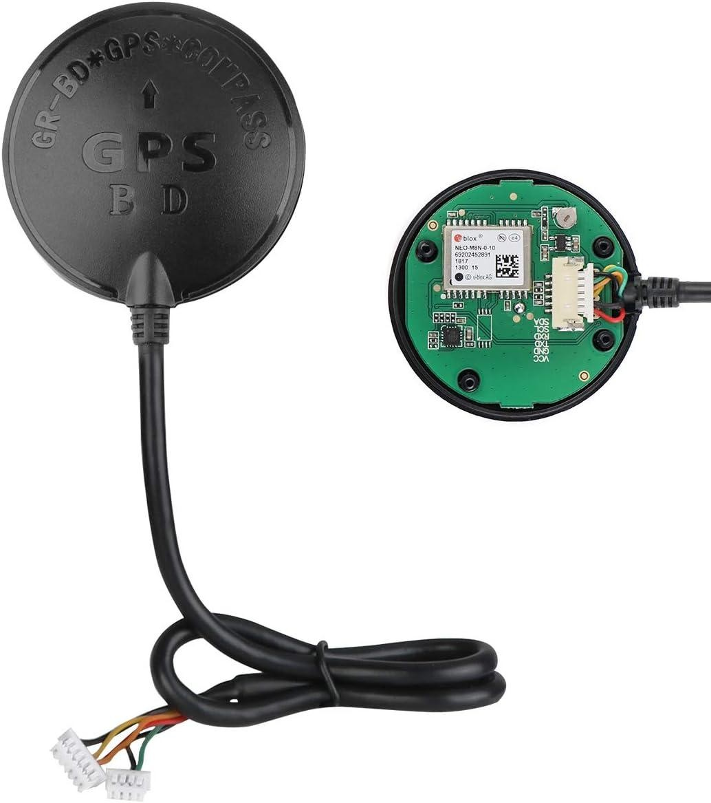
Department of ECE
GPS
A GPS (Global Positioning System) in a women protection drone helps in real- time tracking, autonomous navigation, and emergency response. It ensures the drone can follow the user, send location alerts, and return to safety if needed. As shown in below figure -1.5 GPS(Global Positioning System)
Fig -1.5 GPS (Global Positioning System)

Slide 13
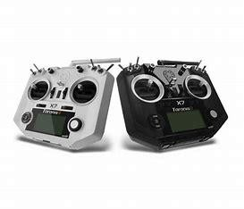
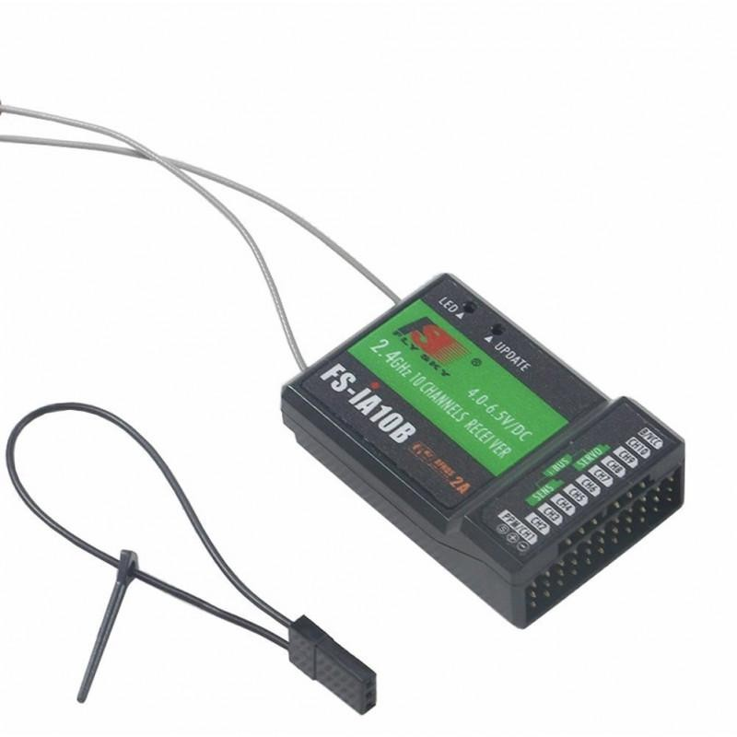
TRANSMITTER(TX) & RECEIVER(RX)
A transmitter (TX) and receiver (RX) in a women protection drone allow wireless communication between the drone and the user. They help in controlling the drone, sending safety alerts, and enabling real- time tracking. As shown in below figure-1.6&figure-1.7 are Transmitter and Receiver
Department of ECE
Fig-1.6Transmitter (TX)
Fig-1.7 Receiver (RX)

Slide 14
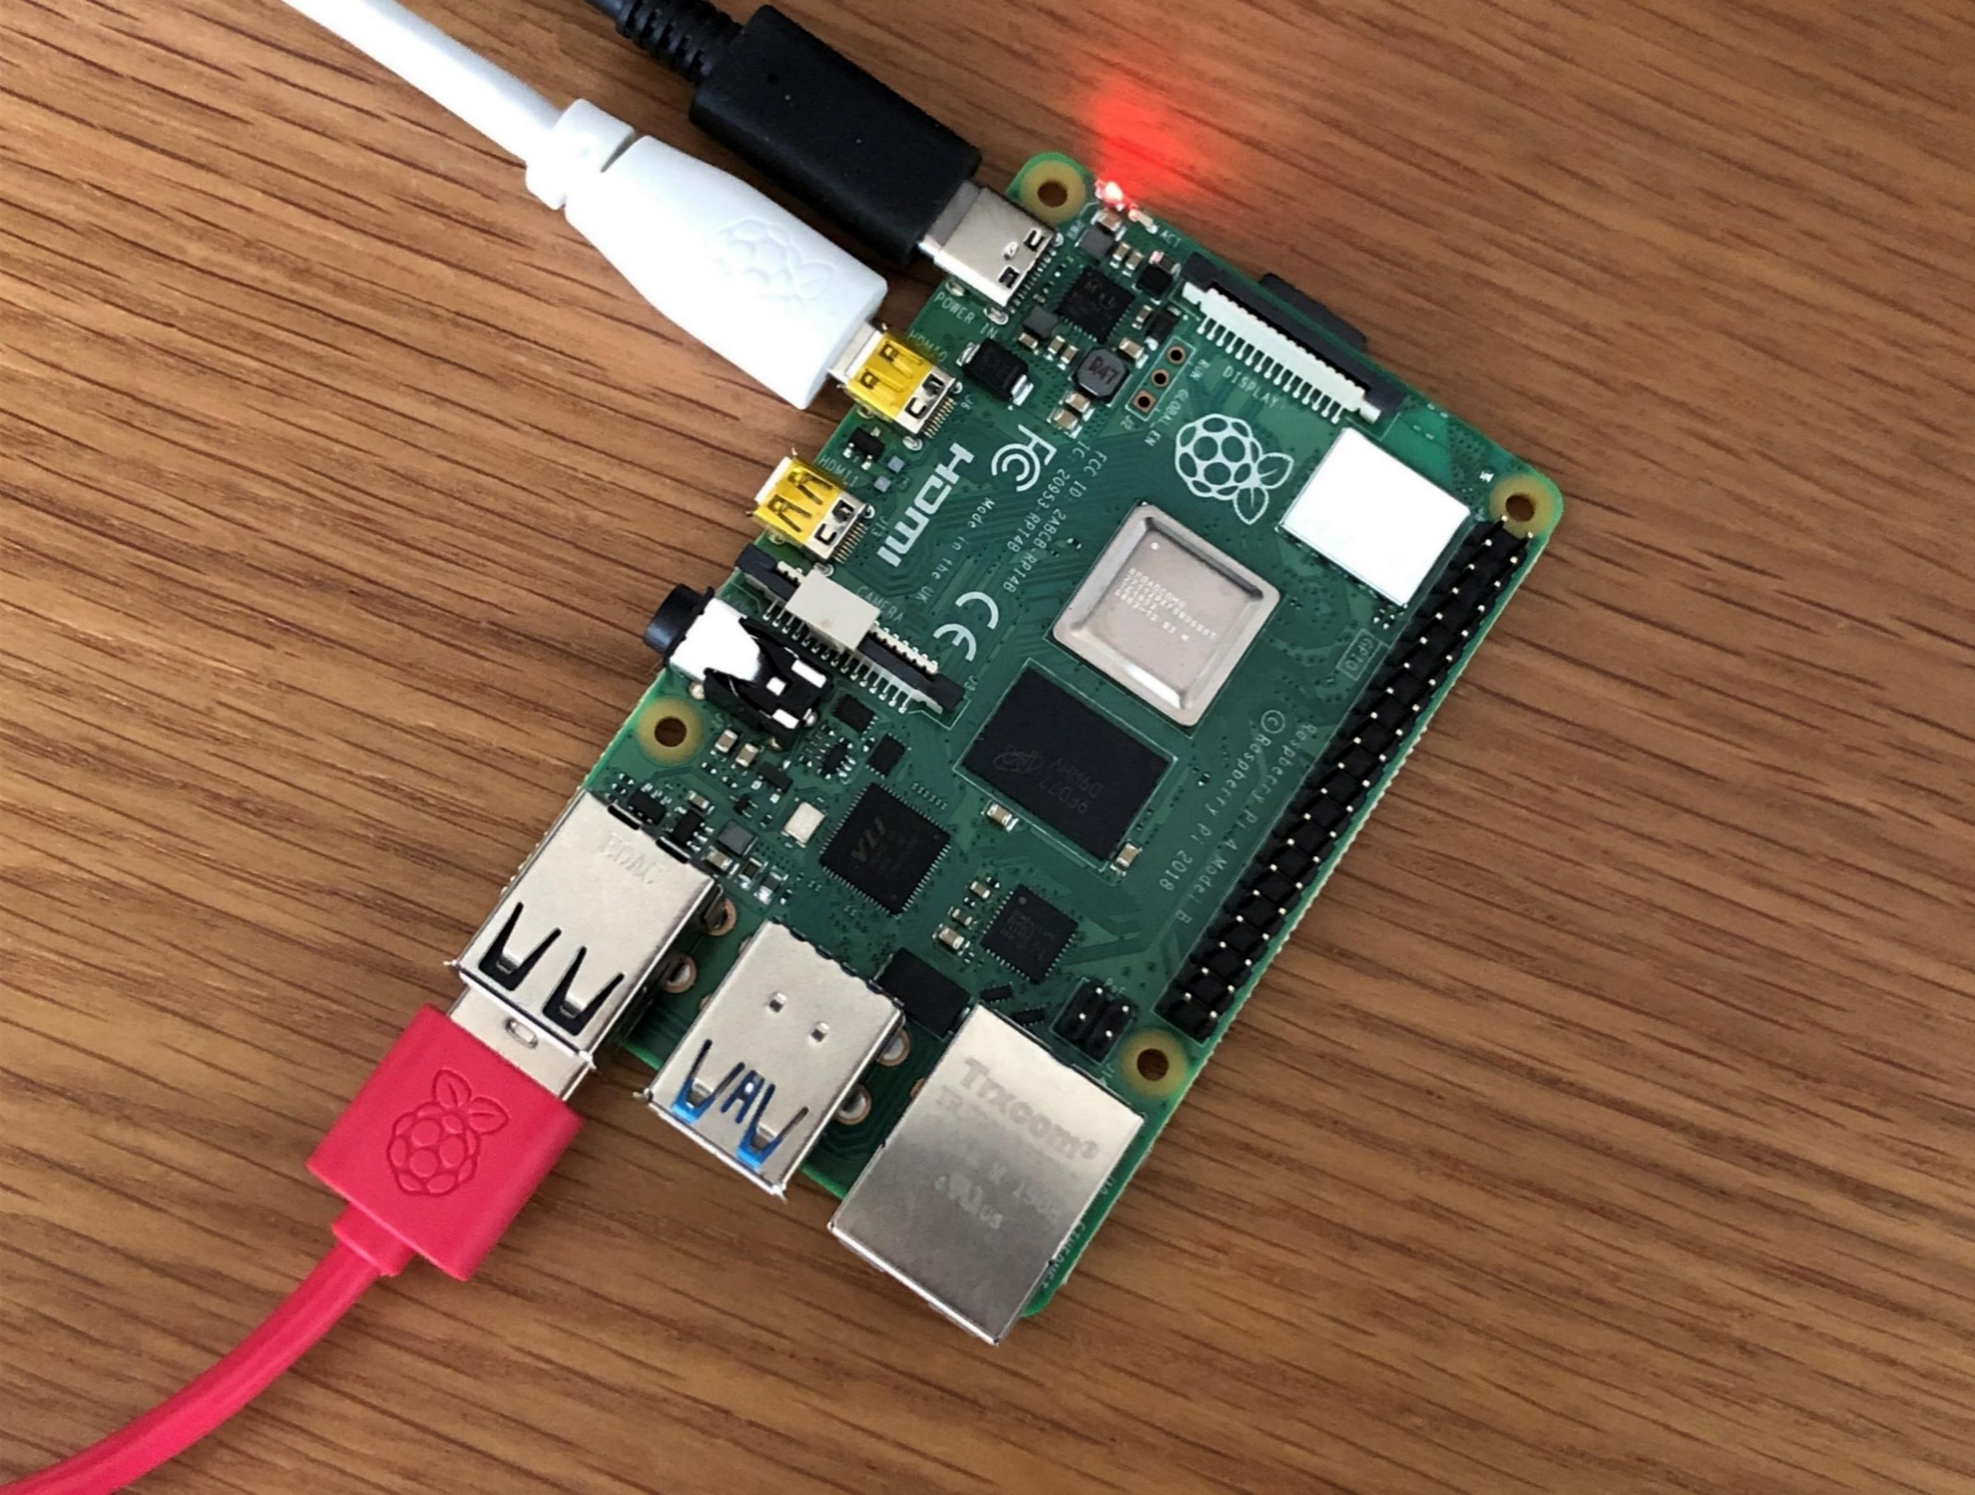
RASPBERRY PI
For autonomous operations, we've integrated an onboard computer, such as the Raspberry Pi 3B+ or Raspberry Pi 4, depending on the specific requirements of your application. As shown in below figure -1.8 Raspberry Pi
Department of ECE
Fig -1.8 Raspberry Pi

Slide 15
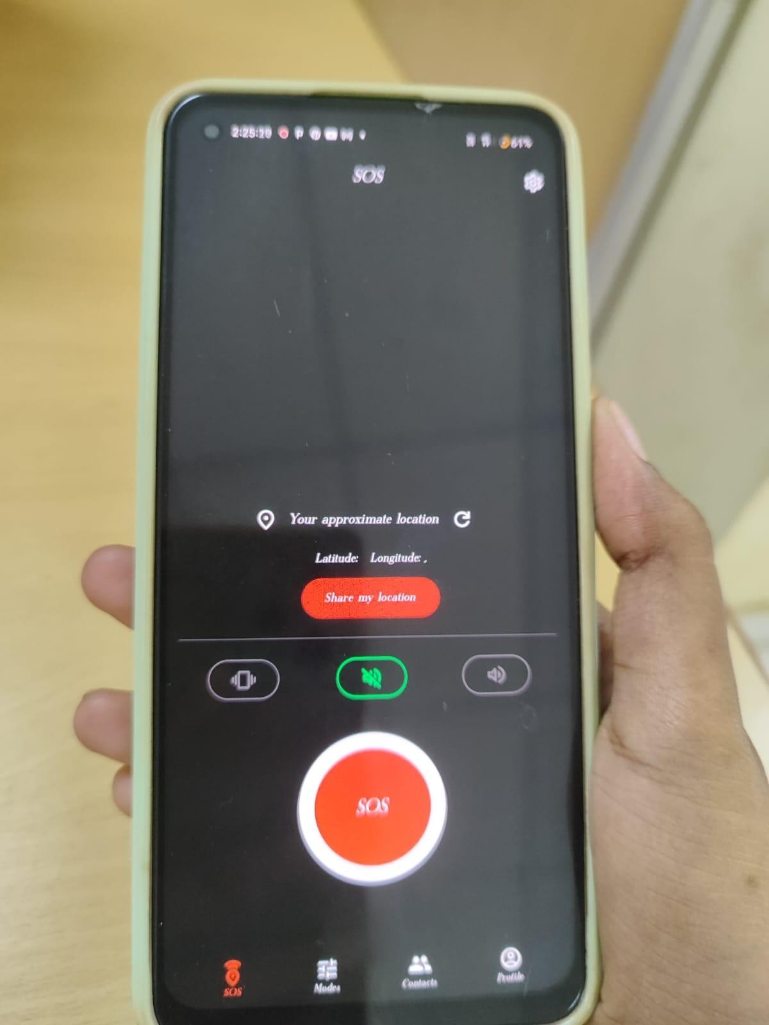
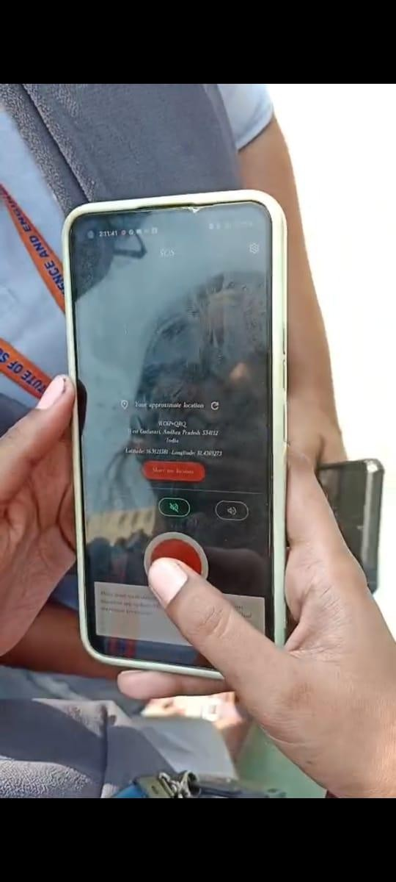
EXPERIMENTAL RESULT
Department of ECE
Open SOS App
Click The SOS Button
▶

Slide 16
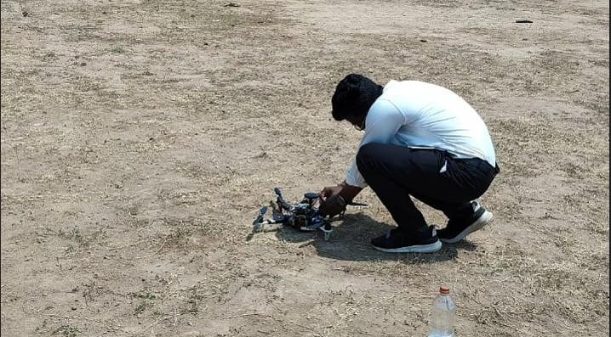
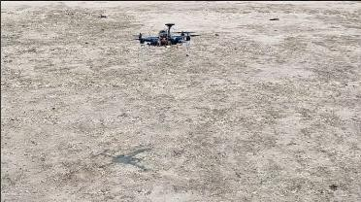
Department of ECE
Battery Plug In
Ready To Fly

Slide 17
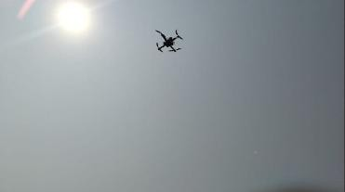
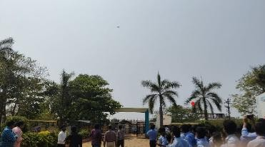
Department of ECE
Maximum height
Alerting people

Slide 18
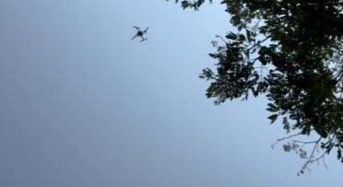
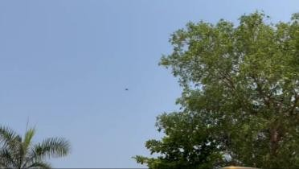
Department of ECE
Searching For Victim
Taking Images

Slide 19
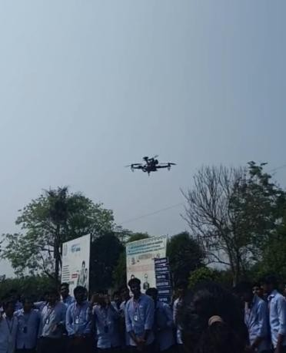
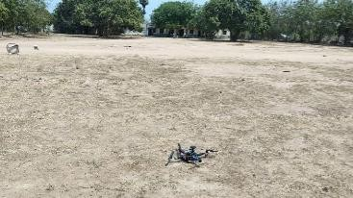
Department of ECE
Step9
Step10
Back to Location
Return To Launch

Slide 20
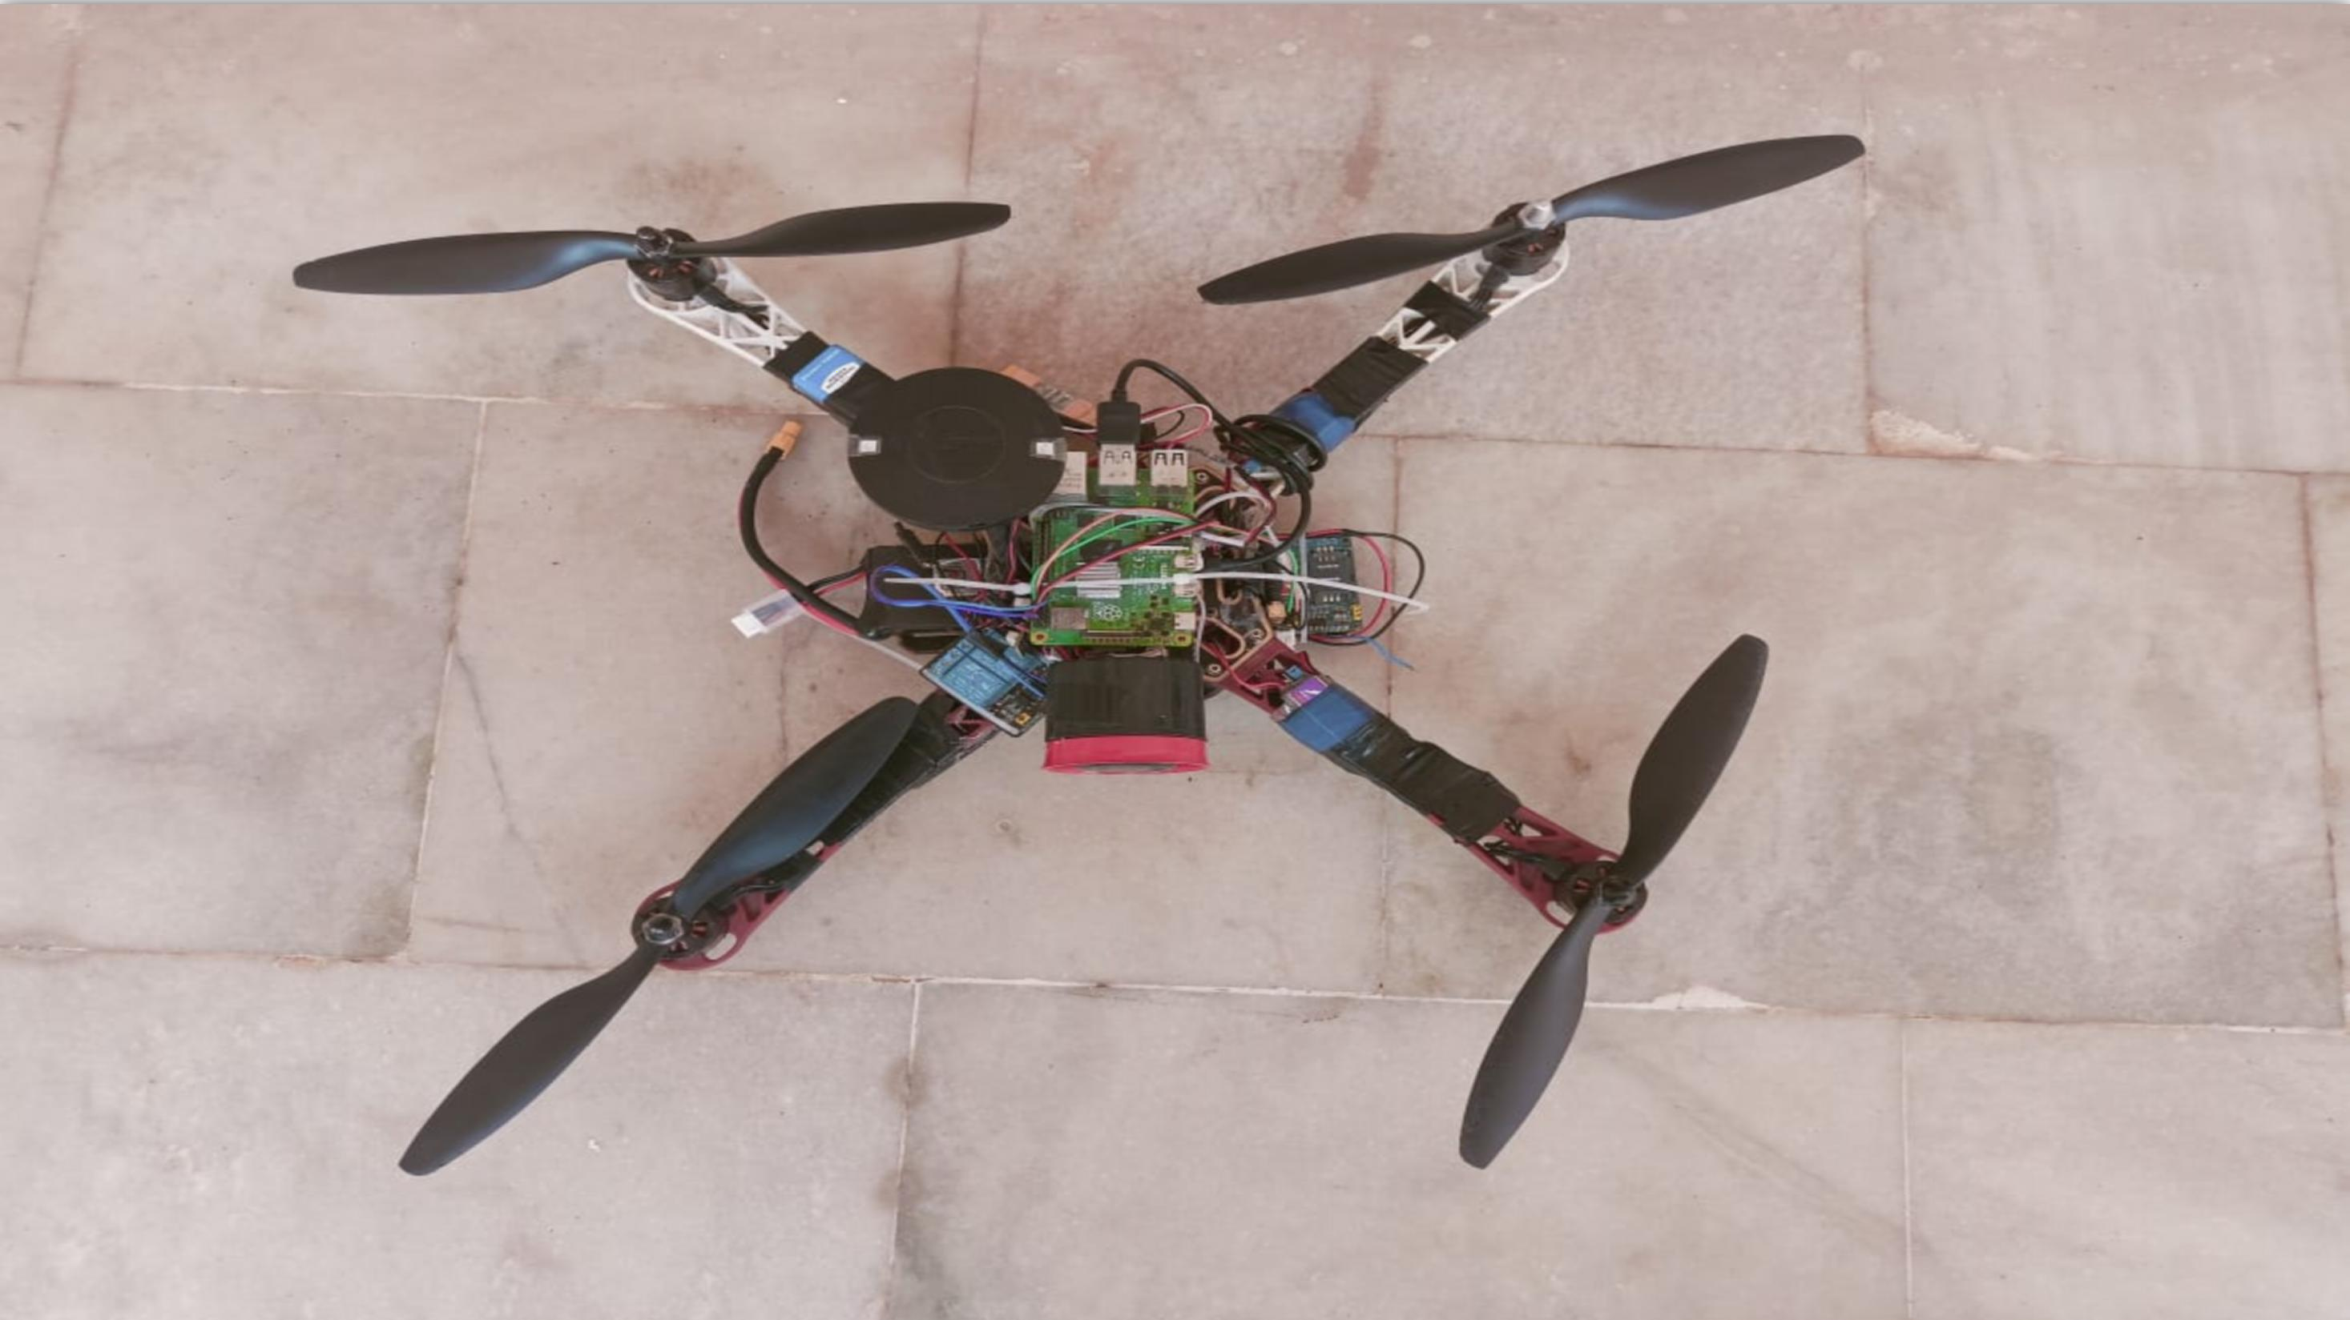

Department of ECE

Slide 21
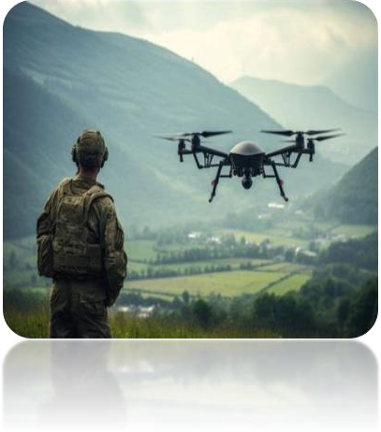
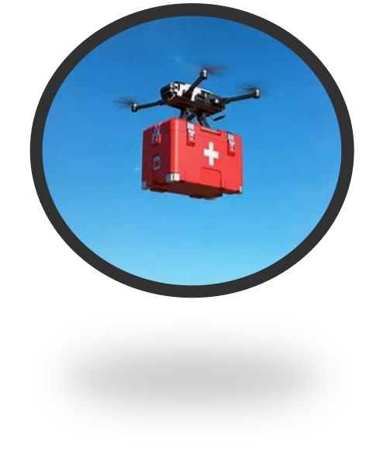
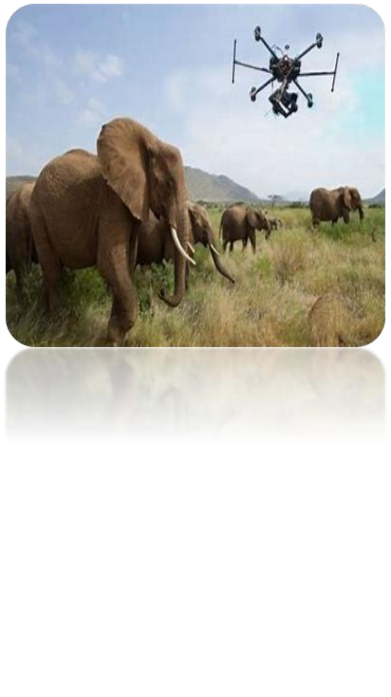
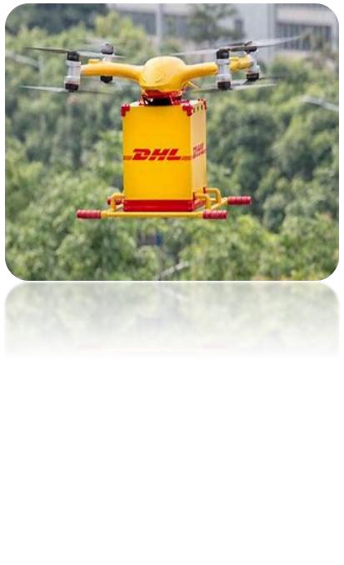
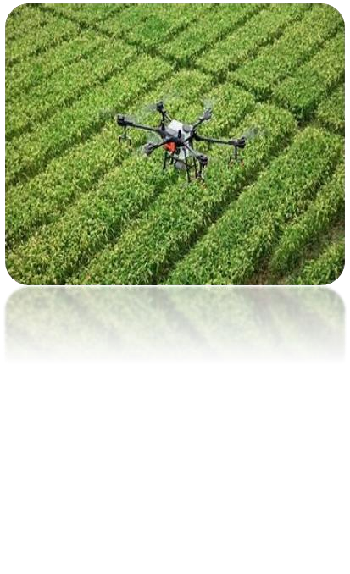

APPLICATIONS
Department of ECE
Military drones
Drones for delivery
Drones for emergency rescue
Drones in agriculture
Drones for wildlife
Drones in medicine
Drones for photography
Drones for historical conservation

Slide 22
Department of ECE
ADVANTAGES
Quick Emergency Response
Remote Monitoring & control
Threat Detection
Data collection
GPS & SOS Alerts
Real-time Surveillance & Tracking

Slide 23
CONCLUSON
Department of ECE
Women Protection Drone is a smart safety tool that helps in tracking, monitoring, and alerting during emergencies. It provides quick response, real-time surveillance, and GPS alerts, making it useful for women's security. However, challenges like high cost, battery limitations, and privacy issues need to be improved. With better technology and proper regulations, these drones can become an effective solution for women's safety in the future

Slide 24
ANY QUERIES ?
Department of ECE

Slide 25
THANK YOU
Department of ECE

